Slide 1
Parallel and Distributed Computing
CS3006
Lecture 3 & 4

Slide 2
Outline
Flynn’s Taxonomy
2.3. Dichotomy of Parallel Computing Platforms
2.4. Physical Organization of Parallel Platforms
2.5. Communication Costs in Parallel Machines
Notes:
What and when

Slide 3
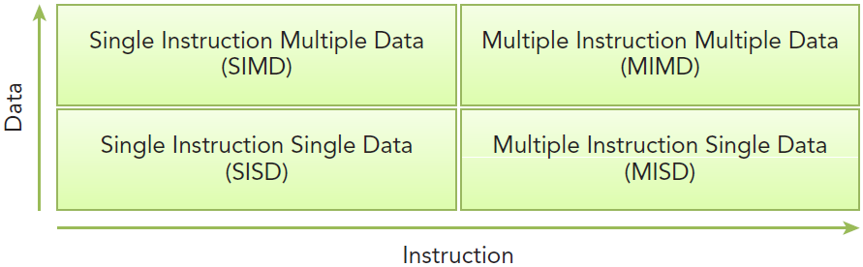
Flynn’s Taxonomy
Widely used architectural classification scheme
Classifies architectures into four types
The classification is based on how data and instructions flow through the cores.

Slide 4
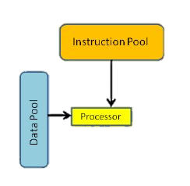
Flynn’s Taxonomy
SISD (Single Instruction Single Data)
Refers to traditional computer: a serial architecture
This architecture includes single core computers
Single instruction stream is in execution at a given time
Similarly, only one data stream is active at any time
Notes:
Not parallel, classical Von Neumann architecture
Parallelism can be introduced using pipelining

Slide 5
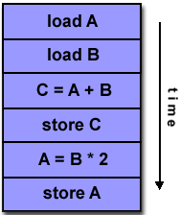
Example of SISD:

Slide 6
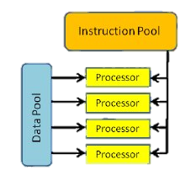
Flynn’s Taxonomy
SIMD (Single Instruction Multiple Data)
Refers to parallel architecture with multiple cores
All the cores execute the same instruction stream at any time but, data stream is different for the each.
Well-suited for the scientific operations requiring large matrix-vector operations
Vector computers (Cray vector processing machine) and Intel co-processing unit ‘MMX’ fall under this category.
Used with array operations, image processing and graphics
Notes:
Array: same operations on different array elements. Replaces the loops
Image: Applying same operation on different pixels

Slide 7
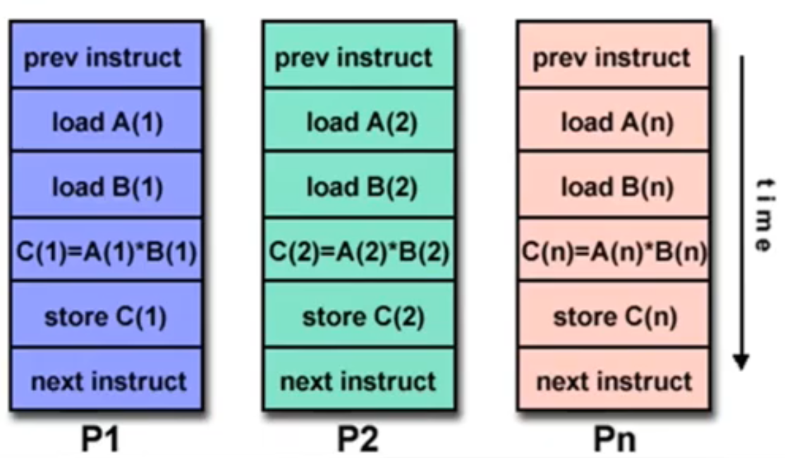
Example of SIMD:

Slide 8
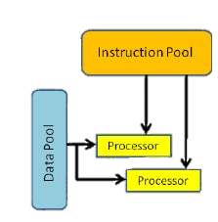
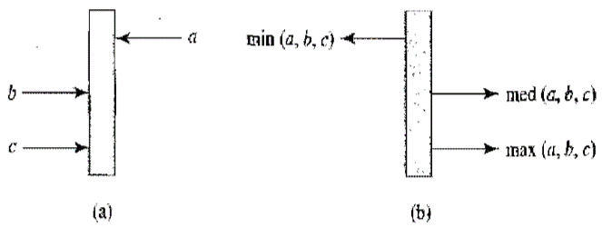
Flynn’s Taxonomy
MISD (Multiple Instructions Single Data)
Multiple instruction stream and single data stream
A pipeline of multiple independently executing functional units
Each operating on a single stream of data and forwarding results from one to the next
Rarely used in practice
E.g., Systolic arrays : network of primitive processing elements that pump data.
Notes:
In parallel computer architectures, a systolic array is a homogeneous [similar] network of tightly coupled data processing units called cells or nodes.

Slide 9
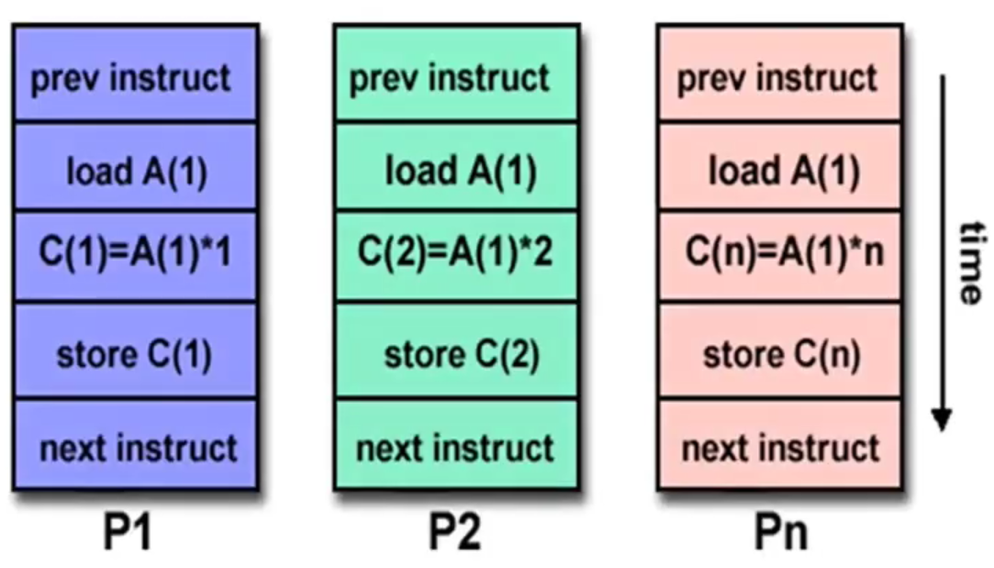
Example of MISD:

Slide 10
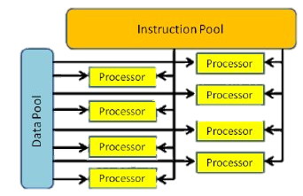
Flynn’s Taxonomy
MIMD (Multiple Instructions Multiple Data)
Multiple instruction streams and multiple data streams
Different CPUs can simultaneously execute different instruction streams manipulating different data
Most of the modern parallel architectures fall under this category e.g., Multiprocessor and multicomputer architectures
Many MIMD architectures include SIMD executions by default.
Notes:
e.g. super computers

Slide 11
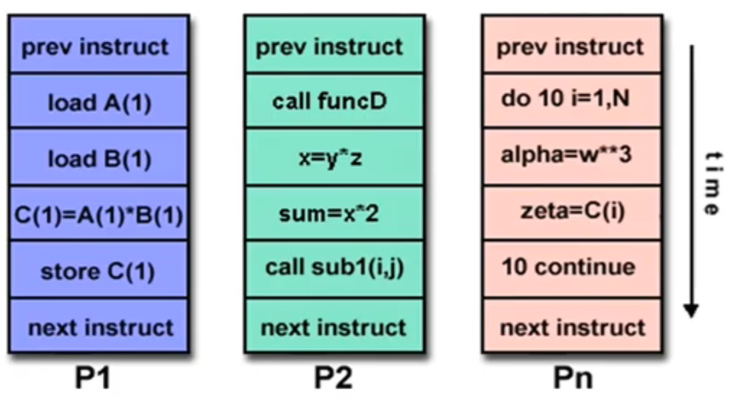
Example of MIMD:

Slide 12
Flynn’s Taxonomy
A typical SIMD architecture (a) and a typical MIMD architecture (b).

Slide 13
2.3. Dichotomy of Parallel Computing Platforms
An explicitly parallel program must specify concurrency and interaction between concurrent subtasks.
The former is sometimes also referred to as the control structure and the latter as the communication model.

Slide 14
Control Structure of Parallel Programs
Parallelism can be expressed at various levels of granularity - from instruction level to processes.
Between these extremes exist a range of models, along with corresponding architectural support.

Slide 15
Control Structure of Parallel Programs
Processing units in parallel computers either operate under the centralized control of a single control unit or work independently.
If there is a single control unit that dispatches the same instruction to various processors (that work on different data), the model is referred to as single instruction stream, multiple data stream (SIMD).
If each processor has its own control control unit, each processor can execute different instructions on different data items. This model is called multiple instruction stream, multiple data stream (MIMD).

Slide 16
SIMD and MIMD Processors
A typical SIMD architecture (a) and a typical MIMD architecture (b).

Slide 17
SIMD Processors
Some of the earliest parallel computers such as the Illiac IV, MPP, DAP, CM-2, and MasPar MP-1 belonged to this class of machines.
Variants of this concept have found use in co-processing units such as the MMX units in Intel processors and DSP chips such as the Sharc.
SIMD relies on the regular structure of computations (such as those in image processing).
It is often necessary to selectively turn off operations on certain data items. For this reason, most SIMD programming paradigms allow for an ``activity mask'', which determines if a processor should participate in a computation or not.

Slide 18
Conditional Execution in SIMD Processors
Executing a conditional statement on an SIMD computer with four processors: (a) the conditional statement; (b) the execution of the statement in two steps.

Slide 19
MIMD Processors
In contrast to SIMD processors, MIMD processors can execute different programs on different processors.
A variant of this, called single program multiple data streams (SPMD) executes the same program on different processors.
It is easy to see that SPMD and MIMD are closely related in terms of programming flexibility and underlying architectural support.
Examples of such platforms include current generation Sun Ultra Servers, SGI Origin Servers, multiprocessor PCs, workstation clusters, and the IBM SP.

Slide 20
SIMD-MIMD Comparison
SIMD computers require less hardware than MIMD computers (single control unit).
However, since SIMD processors ae specially designed, they tend to be expensive and have long design cycles.
Not all applications are naturally suited to SIMD processors.
In contrast, platforms supporting the SPMD paradigm can be built from inexpensive off-the-shelf components with relatively little effort in a short amount of time.

Slide 21
Communication Model of Parallel Platforms
There are two primary forms of data exchange between parallel tasks - accessing a shared data space and exchanging messages.
Platforms that provide a shared data space are called shared-address-space machines or multiprocessors.
Platforms that support messaging are also called message passing platforms or multicomputers.

Slide 22
Shared-Address-Space Platforms
Part (or all) of the memory is accessible to all processors.
Processors interact by modifying data objects stored in this shared-address-space.
If the time taken by a processor to access any memory word in the system global or local is identical, the platform is classified as a uniform memory access (UMA), else, a non-uniform memory access (NUMA) machine.

Slide 23
NUMA and UMA Shared-Address-Space Platforms
Typical shared-address-space architectures: (a) Uniform-memory access shared-address-space computer; (b) Uniform-memory-access shared-address-space computer with caches and memories; (c) Non-uniform-memory-access shared-address-space computer with local memory only.

Slide 24
NUMA and UMA Shared-Address-Space Platforms
The distinction between NUMA and UMA platforms is important from the point of view of algorithm design. NUMA machines require locality from underlying algorithms for performance.
Programming these platforms is easier since reads and writes are implicitly visible to other processors.
However, read-write data to shared data must be coordinated (this will be discussed in greater detail when we talk about threads programming).
Caches in such machines require coordinated access to multiple copies. This leads to the cache coherence problem.
A weaker model of these machines provides an address map, but not coordinated access. These models are called non cache coherent shared address space machines.

Slide 25
Shared-Address-Space vs. Shared Memory Machines
It is important to note the difference between the terms shared address space and shared memory.
We refer to the former as a programming abstraction and to the latter as a physical machine attribute.
It is possible to provide a shared address space using a physically distributed memory.

Slide 26
Message-Passing Platforms
These platforms comprise of a set of processors and their own (exclusive) memory.
Instances of such a view come naturally from clustered workstations and non-shared-address-space multicomputers.
These platforms are programmed using (variants of) send and receive primitives.
Libraries such as MPI and PVM provide such primitives.

Slide 27
Message Passing vs. Shared Address Space Platforms
Message passing requires little hardware support, other than a network.
Shared address space platforms can easily emulate message passing. The reverse is more difficult to do (in an efficient manner).

Slide 28
2.4. Physical Organization of Parallel Platforms
We begin this discussion with an ideal parallel machine called Parallel Random Access Machine, or PRAM.

Slide 29
Architecture of an Ideal Parallel Computer
A natural extension of the Random Access Machine (RAM) serial architecture is the Parallel Random Access Machine, or PRAM.
PRAMs consist of p processors and a global memory of unbounded size that is uniformly accessible to all processors.
Processors share a common clock but may execute different instructions in each cycle.

Slide 30
Architecture of an Ideal Parallel Computer
Depending on how simultaneous memory accesses are handled, PRAMs can be divided into four subclasses.
Exclusive-read, exclusive-write (EREW) PRAM.
Concurrent-read, exclusive-write (CREW) PRAM.
Exclusive-read, concurrent-write (ERCW) PRAM.
Concurrent-read, concurrent-write (CRCW) PRAM.

Slide 31
Architecture of an Ideal Parallel Computer
What does concurrent write mean, anyway?
Common: write only if all values are identical.
Arbitrary: write the data from a randomly selected processor.
Priority: follow a predetermined priority order.
Sum: Write the sum of all data items.

Slide 32
Physical Complexity of an Ideal Parallel Computer
Processors and memories are connected via switches.
Since these switches must operate in O(1) time at the level of words, for a system of p processors and m words, the switch complexity is O(mp).
Clearly, for meaningful values of p and m, a true PRAM is not realizable.

Slide 33
Interconnection Networks for Parallel Computers
Interconnection networks carry data between processors and to memory.
Interconnects are made of switches and links (wires, fiber).
Interconnects are classified as static or dynamic.
Static networks consist of point-to-point communication links among processing nodes and are also referred to as direct networks.
Dynamic networks are built using switches and communication links. Dynamic networks are also referred to as indirect networks.

Slide 34
Static and Dynamic Interconnection Networks
Classification of interconnection networks: (a) a static network; and (b) a dynamic network.

Slide 35
Interconnection Networks
Switches map a fixed number of inputs to outputs.
The total number of ports on a switch is the degree of the switch.
The cost of a switch grows as the square of the degree of the switch, the peripheral hardware linearly as the degree, and the packaging costs linearly as the number of pins.

Slide 36
Interconnection Networks: Network Interfaces
Processors talk to the network via a network interface.
The network interface may hang off the I/O bus or the memory bus.
In a physical sense, this distinguishes a cluster from a tightly coupled multicomputer.
The relative speeds of the I/O and memory buses impact the performance of the network.

Slide 37
Network Topologies
A variety of network topologies have been proposed and implemented.
These topologies tradeoff performance for cost.
Commercial machines often implement hybrids of multiple topologies for reasons of packaging, cost, and available components.

Slide 38
Network Topologies: Buses
Some of the simplest and earliest parallel machines used buses.
All processors access a common bus for exchanging data.
The distance between any two nodes is O(1) in a bus. The bus also provides a convenient broadcast media.
However, the bandwidth of the shared bus is a major bottleneck.
Typical bus based machines are limited to dozens of nodes. Sun Enterprise servers and Intel Pentium based shared-bus multiprocessors are examples of such architectures.

Slide 39
Network Topologies: Buses
Bus-based interconnects (a) with no local caches; (b) with local memory/caches.
Since much of the data accessed by processors is local to the processor, a local memory can improve the performance of bus-based machines.

Slide 40
Network Topologies: Crossbars
A crossbar network uses an p×m grid of switches to connect p inputs to m outputs in a non-blocking manner.
A completely non-blocking crossbar network connecting p processors to b memory banks.

Slide 41
Network Topologies: Crossbars
The cost of a crossbar of p processors grows as O(p²).
This is generally difficult to scale for large values of p.
Examples of machines that employ crossbars include the Sun Ultra HPC 10000 and the Fujitsu VPP500.

Slide 42
Network Topologies: Multistage Networks
Crossbars have excellent performance scalability but poor cost scalability.
Buses have excellent cost scalability, but poor performance scalability.
Multistage interconnects strike a compromise between these extremes.

Slide 43
Network Topologies: Multistage Networks
The schematic of a typical multistage interconnection network.

Slide 44
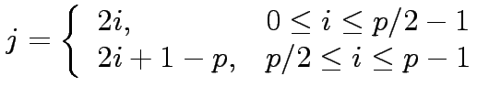
Network Topologies: Multistage Omega Network
One of the most commonly used multistage interconnects is the Omega network.
This network consists of log p stages, where p is the number of inputs/outputs.
At each stage, input i is connected to output j if:

Slide 45
Network Topologies: Multistage Omega Network
Each stage of the Omega network implements a perfect shuffle as follows:
A perfect shuffle interconnection for eight inputs and outputs.

Slide 46
Network Topologies: Multistage Omega Network
The perfect shuffle patterns are connected using 2×2 switches.
The switches operate in two modes – crossover or passthrough.
Two switching configurations of the 2 × 2 switch:
(a) Pass-through; (b) Cross-over.

Slide 47
Network Topologies: Multistage Omega Network
A complete Omega network with the perfect shuffle interconnects and switches can now be illustrated:
A complete omega network connecting eight inputs and eight outputs.
An omega network has p/2 × log p switching nodes, and the cost of such a network grows as (p log p).

Slide 48
Network Topologies: Multistage Omega Network – Routing
Let s be the binary representation of the source and d be that of the destination processor.
The data traverses the link to the first switching node. If the most significant bits of s and d are the same, then the data is routed in pass-through mode by the switch else, it switches to crossover.
This process is repeated for each of the log p switching stages.
Note that this is not a non-blocking switch.

Slide 49
Network Topologies: Multistage Omega Network – Routing
An example of blocking in omega network: one of the messages
(010 to 111 or 110 to 100) is blocked at link AB.

Slide 50
Network Topologies: Completely Connected Network
Each processor is connected to every other processor.
The number of links in the network scales as O(p²).
While the performance scales very well, the hardware complexity is not realizable for large values of p.
In this sense, these networks are static counterparts of crossbars.

Slide 51
Network Topologies: Completely Connected and Star Connected Networks
Example of an 8-node completely connected network.
(a) A completely-connected network of eight nodes;
(b) a star connected network of nine nodes.

Slide 52
Network Topologies: Star Connected Network
Every node is connected only to a common node at the center.
Distance between any pair of nodes is O(1). However, the central node becomes a bottleneck.
In this sense, star connected networks are static counterparts of buses.

Slide 53
Network Topologies: Linear Arrays, Meshes, and k-d Meshes
In a linear array, each node has two neighbors, one to its left and one to its right. If the nodes at either end are connected, we refer to it as a 1-D torus or a ring.
A generalization to 2 dimensions has nodes with 4 neighbors, to the north, south, east, and west.
A further generalization to d dimensions has nodes with 2d neighbors.
A special case of a d-dimensional mesh is a hypercube. Here, d = log p, where p is the total number of nodes.

Slide 54
Network Topologies: Linear Arrays
Linear arrays: (a) with no wraparound links; (b) with wraparound link.

Slide 55
Network Topologies: Two- and Three Dimensional Meshes
Two and three dimensional meshes: (a) 2-D mesh with no wraparound; (b) 2-D mesh with wraparound link (2-D torus); and (c) a 3-D mesh with no wraparound.

Slide 56
Network Topologies: Hypercubes and their Construction
Construction of hypercubes from hypercubes of lower dimension.

Slide 57
Network Topologies: Properties of Hypercubes
The distance between any two nodes is at most log p.
Each node has log p neighbors.
The distance between two nodes is given by the number of bit positions at which the two nodes differ.

Slide 58
Network Topologies: Tree-Based Networks
Complete binary tree networks: (a) a static tree network; and (b) a dynamic tree network.

Slide 59
Network Topologies: Tree Properties
The distance between any two nodes is no more than 2logp.
Links higher up the tree potentially carry more traffic than those at the lower levels.
For this reason, a variant called a fat-tree, fattens the links as we go up the tree.
Trees can be laid out in 2D with no wire crossings. This is an attractive property of trees.

Slide 60
Network Topologies: Fat Trees
A fat tree network of 16 processing nodes.

Slide 61

Evaluating Static Interconnection Networks
Diameter: The distance between the farthest two nodes in the network. The diameter of a linear array is p − 1, that of a mesh is 2( − 1), that of a tree and hypercube is log p, and that of a completely connected network is O(1).
Bisection Width: The minimum number of wires you must cut to divide the network into two equal parts. The bisection width of a linear array and tree is 1, that of a mesh is , that of a hypercube is p/2 and that of a completely connected network is p²/4.
Cost: The number of links or switches (whichever is asymptotically higher) is a meaningful measure of the cost. However, a number of other factors, such as the ability to layout the network, the length of wires, etc., also factor in to the cost.

Slide 62

















Evaluating Static Interconnection Networks
Network | Diameter | BisectionWidth | Arc Connectivity | Cost (No. of links)
Completely-connected
Star
Complete binary tree
Linear array
2-D mesh, no wraparound
2-D wraparound mesh
Hypercube
Wraparound k-ary d-cube

Slide 63





Evaluating Dynamic Interconnection Networks
Network | Diameter | Bisection Width | Arc Connectivity | Cost (No. of links)
Crossbar
Omega Network
Dynamic Tree

Slide 64
2.5. Communication Costs in Parallel Machines
Along with idling (doing nothing) and contention (conflict e.g., resource allocation), communication is a major overhead in parallel programs.
The communication cost is usually dependent on a number of features including the following:
Programming model for communication
Network topology
Data handling and routing
Associated network protocols
Usually, distributed systems suffer from major communication overheads.
Notes:
Programming model for communication—Required pattern of the communication in the program
Associated protocols: Security assessments UDP,TCP,

Slide 65
Message Passing Costs in Parallel Computers
The total time to transfer a message over a network comprises of the following:
Startup time (t_{s}): Time spent at sending and receiving nodes (preparing the message[adding headers, trailers, and parity information ] , executing the routing algorithm, establishing interface between node and router, etc.).
Per-hop time (t_{h}): This time is a function of number of hops (steps) and includes factors such as switch latencies, network delays, etc.
Also known as node latency.
Per-word transfer time (t_{w}): This time includes all overheads that are determined by the length of the message. This includes bandwidth of links, and buffering overheads, etc.
Notes:
t_{h} also accounts for the latency to take decision of choosing next channel to which this message shall be forwarded
If channel bandwidth is r words/s then each word take t_{w}= 1/r to traverse the link.

Slide 66


Message Passing Costs in Parallel Computers
Store-and-Forward Routing
A message traversing multiple hops is completely received at an intermediate hop before being forwarded to the next hop.
The total communication cost for a message of size m words to traverse l communication links is
In most platforms, t_{h} is small and the above expression can be approximated by
Notes:
Cost of header transfer at each hop (step) t_{h}.
Ts is startup time
Mtw id cost of transferring m words over this link

Slide 67

Message Passing Costs in Parallel Computers
Packet Routing
Store-and-forward makes poor use of communication resources.
Packet routing breaks messages into packets and pipelines them through the network.
Since packets may take different paths, each packet must carry routing information, error checking, sequencing, and other related header information.
The total communication time for packet routing is approximated by:
Here factor t_{w} also accounts for overheads in packet headers.
Notes:
Error checking---parity information
Sequencing---packet order number
Related headers: layers headers, addressing headers

Slide 68
Message Passing Costs in Parallel Computers
Cut-Through Routing
Takes the concept of packet routing to an extreme by further dividing messages into basic units called flits or flow control digits.
Since flits are typically small, the header information must be minimized.
This is done by forcing all flits to take the same path, in sequence.
A tracer message first programs all intermediate routers. All flits then take the same route.
Error checks are performed on the entire message, as opposed to flits.
No sequence numbers are needed.
Notes:
Sequencing information is not needed as all the packets are following same path which ensures in-order delivery

Slide 69
Message Passing Costs in Parallel Computers
Cut-Through Routing
The total communication time for cut-through routing is approximated by:
This is identical to packet routing, however, t_{w} is typically much smaller.
Notes:
Header of the message takes l*t_{h} to reach the destination and entire message arrives in time mt_{w} after the message header

Slide 70
Message Passing Costs in Parallel Computers
(a) through a store-and-forward communication network;
b) and (c) extending the concept to cut-through routing.
Notes:
Shaded regions here represent the time where message is in transit (travel)
The startup time associated with this message transfer is assumed to be zero

Slide 71


Message Passing Costs in Parallel Computers
Simplified Cost Model for Communicating Messages
The cost of communicating a message between two nodes l hops away using cut-through routing is given by
In this expression, t_{h} is typically smaller than t_{s} and t_{w}. For this reason, the second term in the RHS does not show, particularly, when m is large.
For these reasons, we can approximate the cost of message transfer by
Notes:
For communication using flits, start-up time dominates the node latencies.

Slide 72
Message Passing Costs in Parallel Computers
Simplified Cost Model for Communicating Messages
It is important to note that the original expression for communication time is valid for only uncongested networks.
Different communication patterns congest different networks to varying extents.
It is important to understand and account for this in the communication time accordingly.

Slide 73
References
https://www.cs.purdue.edu/homes/ayg/book/Slides/

Slide 74
2.4.6. Cache Coherence in Multiprocessor Systems (Reading Assignment)
Interconnects provide basic mechanisms for data transfer.
In the case of shared address space machines, additional hardware is required to coordinate access to data that might have multiple copies in the network.
The underlying technique must provide some guarantees on the semantics.
This guarantee is generally one of serializability, i.e., there exists some serial order of instruction execution that corresponds to the parallel schedule.

Slide 75
Cache Coherence in Multiprocessor Systems
When the value of a variable is changes, all its copies must either be invalidated or updated.
Cache coherence in multiprocessor systems: (a) Invalidate protocol; (b) Update protocol for shared variables.

Slide 76
Cache Coherence: Update and Invalidate Protocols
If a processor just reads a value once and does not need it again, an update protocol may generate significant overhead.
If two processors make interleaved test and updates to a variable, an update protocol is better.
Both protocols suffer from false sharing overheads (two words that are not shared, however, they lie on the same cache line).
Most current machines use invalidate protocols.

Slide 77
Maintaining Coherence Using Invalidate Protocols
Each copy of a data item is associated with a state.
One example of such a set of states is, shared, invalid, or dirty.
In shared state, there are multiple valid copies of the data item (and therefore, an invalidate would have to be generated on an update).
In dirty state, only one copy exists and therefore, no invalidates need to be generated.
In invalid state, the data copy is invalid, therefore, a read generates a data request (and associated state changes).

Slide 78
Maintaining Coherence Using Invalidate Protocols
State diagram of a simple three-state coherence protocol.

Slide 79
Maintaining Coherence Using Invalidate Protocols
Example of parallel program execution with the simple
three-state coherence protocol.

Slide 80
Snoopy Cache Systems
How are invalidates sent to the right processors?
In snoopy caches, there is a broadcast media that listens to all invalidates and read requests and performs appropriate coherence operations locally.
A simple snoopy bus based cache coherence system.

Slide 81
Performance of Snoopy Caches
Once copies of data are tagged dirty, all subsequent operations can be performed locally on the cache without generating external traffic.
If a data item is read by a number of processors, it transitions to the shared state in the cache and all subsequent read operations become local.
If processors read and update data at the same time, they generate coherence requests on the bus - which is ultimately bandwidth limited.

Slide 82
Directory Based Systems
In snoopy caches, each coherence operation is sent to all processors. This is an inherent limitation.
Why not send coherence requests to only those processors that need to be notified?
This is done using a directory, which maintains a presence vector for each data item (cache line) along with its global state.

Slide 83
Directory Based Systems
Architecture of typical directory based systems: (a) a centralized directory; and (b) a distributed directory.

Slide 84
Performance of Directory Based Schemes
The need for a broadcast media is replaced by the directory.
The additional bits to store the directory may add significant overhead.
The underlying network must be able to carry all the coherence requests.
The directory is a point of contention, therefore, distributed directory schemes must be used.

